Slide 1

First Capstone Project
Alma Striker Team :- Play Store App Review Analysis
Team Members
Chetan Mangale
Amol Waghmare
Mohit Sonwane
Adesh Dhole
Akash Sony

Slide 2
Points for discussion
Discuss the problem statement
Get familiar wih the Busines logic
Connect With the Database
Perform analysis on the Data
Free apps VS Paid apps
Impact of ‘Rating’
Conclusion

Slide 3
Defining the problem statement
As we get the detail data of App store data which we have data in the plane csv format. so now first thing we have to be familiar with the database and try to understand the business logic ..
after that we can actually start our Analyzation on the data..

Slide 4

Introduction to Play store Platform
Play store is an Android Market serves as the official app store for certified devices
running on the Android Operating system.
Developed and Operated by Google, launched on 6th March, 2012.
Also called as Google Play store.
Approximately 3.48 million apps are in Play store.
Each apps are having separate product page with user review and rating system.
All the apps are separated into different categories based on the purpose.

Slide 5
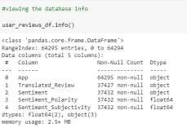
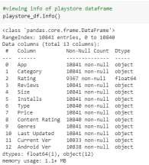
Exploring the database
We have been provided with two databases
User reviews database
Shape of this database is (64295, 5)
Here there are only two numeric values found,
Sentiment Subjectivity, Sentiment Polarity.
Play store app database
Shape of this database is (10841, 13).
Out of this thirteen columns we have numeric
columns like Rating, Reviews, Size, Installs.

Slide 6
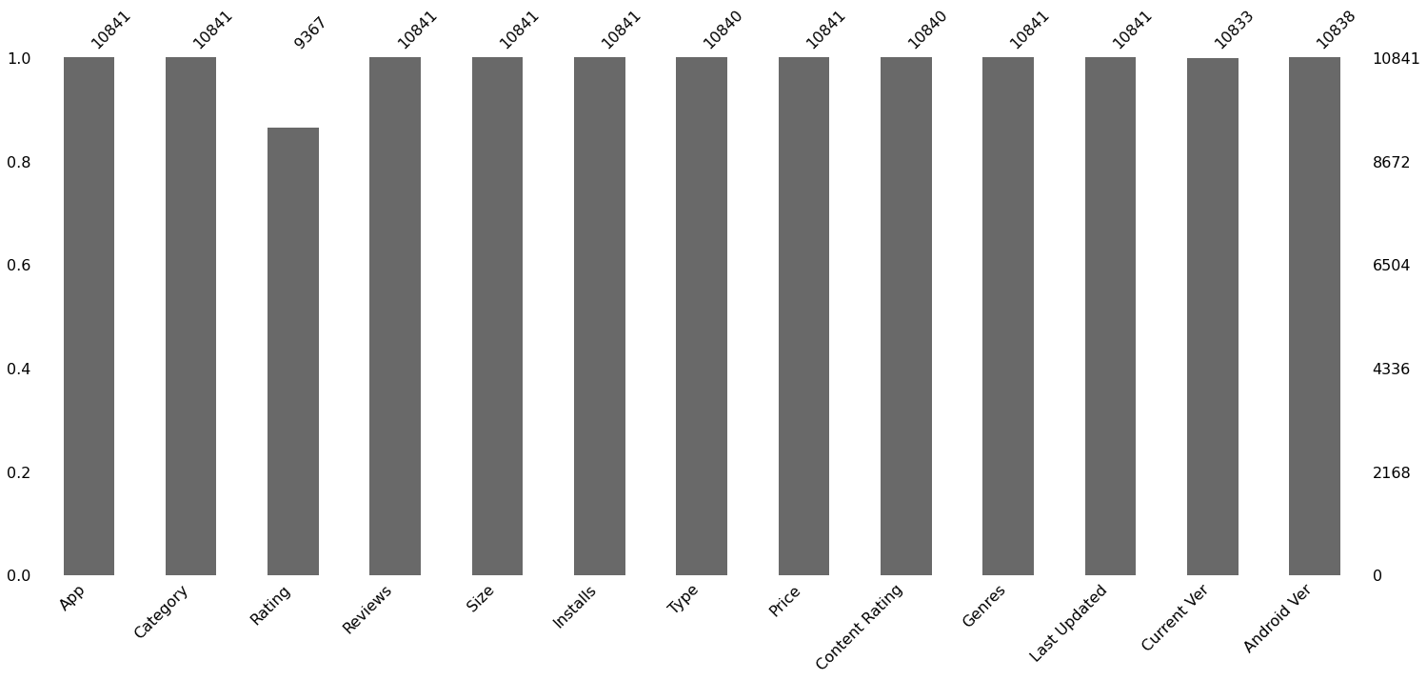
Presents of Null Value of Columns
As we all know ,once we get the data , the vary first step will be find the null values , get the null values ,and try to fix . And if it is not affecting the databses so much then we can clear the rows containing the null values .
The next is the missing value , we also have to deal with that
this two thing will affect whole Data Set if they are not settled.

Slide 7
so after the removing the data which are creating a problem to do analyze , what we do here , we just to print of a graph of two columns , i.e “Categories” and “Apps” .
So on that graph , we got that how many Apps are there with respective each Apps categories.
the graph between categories and apps are shown on next slide , you can check for reference

Slide 8
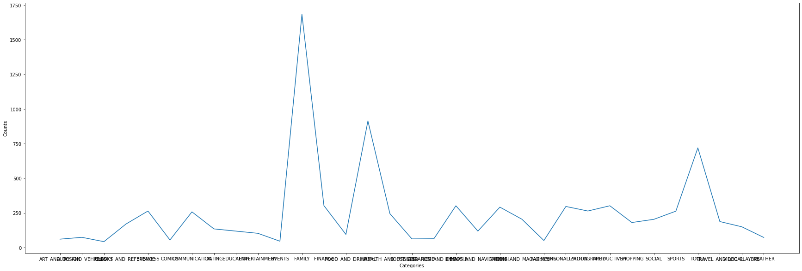
Counts of Categories

Slide 9
Next thing is that we find the top categories of apps with count which are available on play store . so we can get the idea what kind of application of we have in bulk in App store
As the graphs are lill bit big in size , we have to use show it on other page , because , if we minimize the graph , the data will not visible properly.

Slide 10
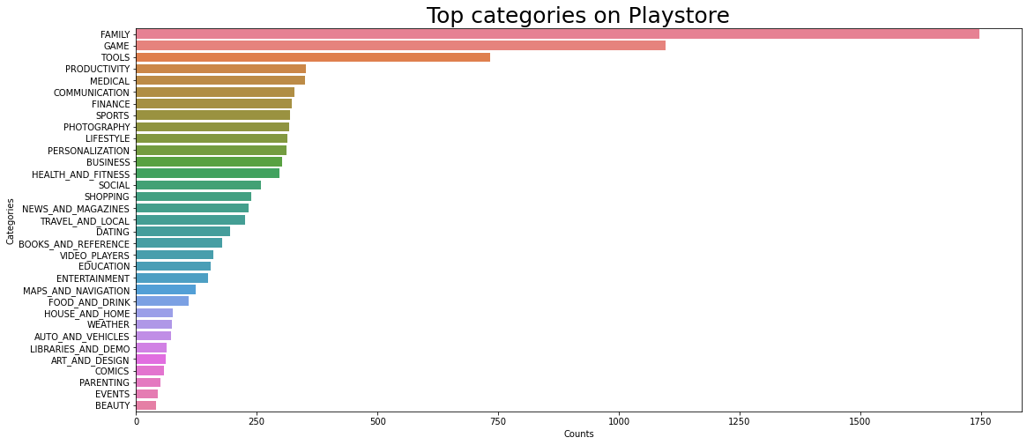
Top Categories On Playstore

Slide 11
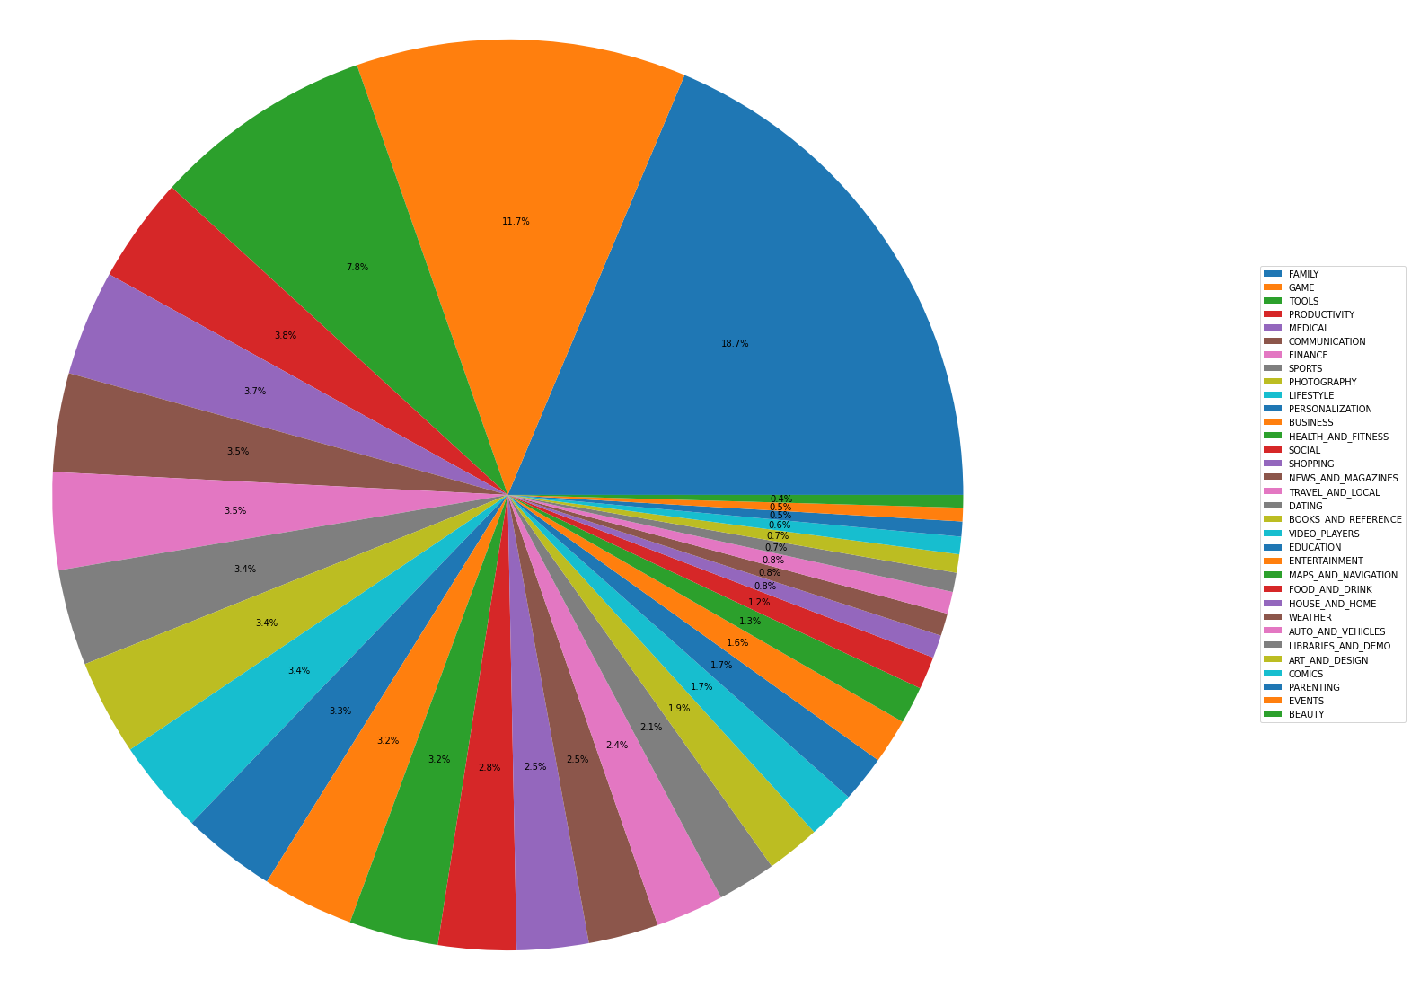
Distribution of Apps across Various Categories

Slide 12
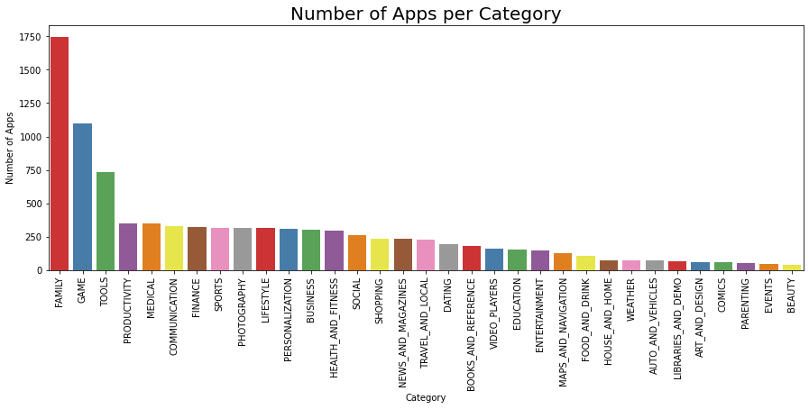
Number of Apps per Category
here as previosly we find the number of apps available on store , so aside that we plot this plot to get the total number of installed apps .
as we saw , these two graphs are not so much different ,

Slide 13
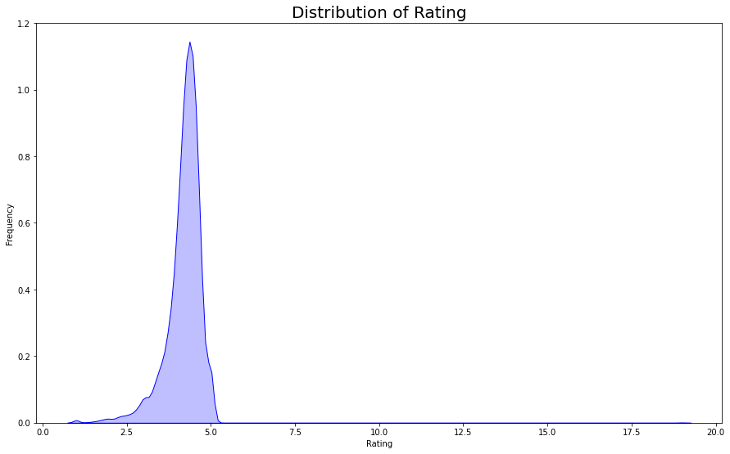
Distribution of ‘Rating’
here we found that the distribution of rating amongsth tha apps .
dby using this chart ,we can found out the mltiple algebric value for a further usage

Slide 14
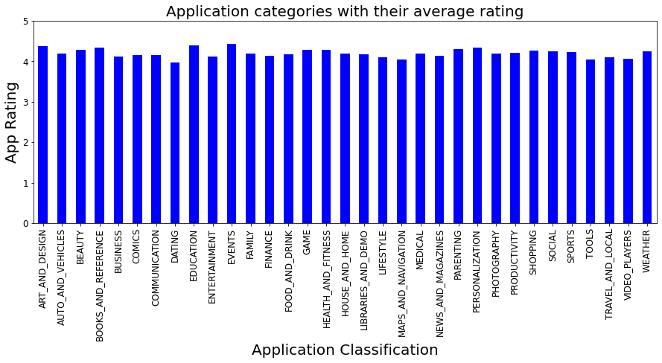
Application Categories with their Average Rating
The average rating Application per application categories is calculated here , so we can get that how the app category is able to delivering result or failed

Slide 15
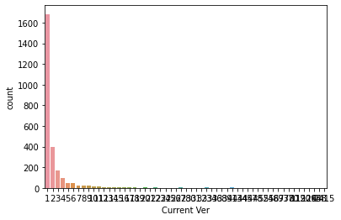
Count of Current Versions on There Basis of
Android Version and Current Version
here we just found the Count of each version of app installed in a system
the detail description of number of apps are installed versus the required android version are shown in next slide , in detail

Slide 16
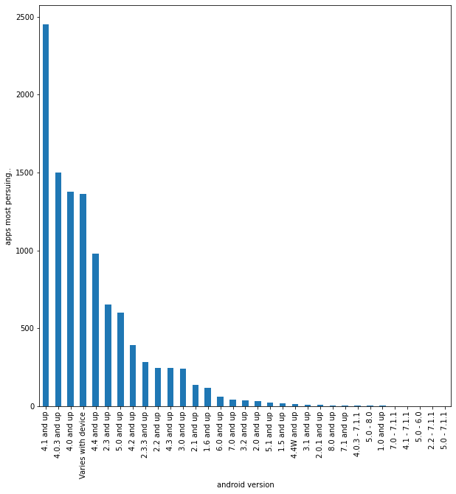
Distribution of Android

Slide 17
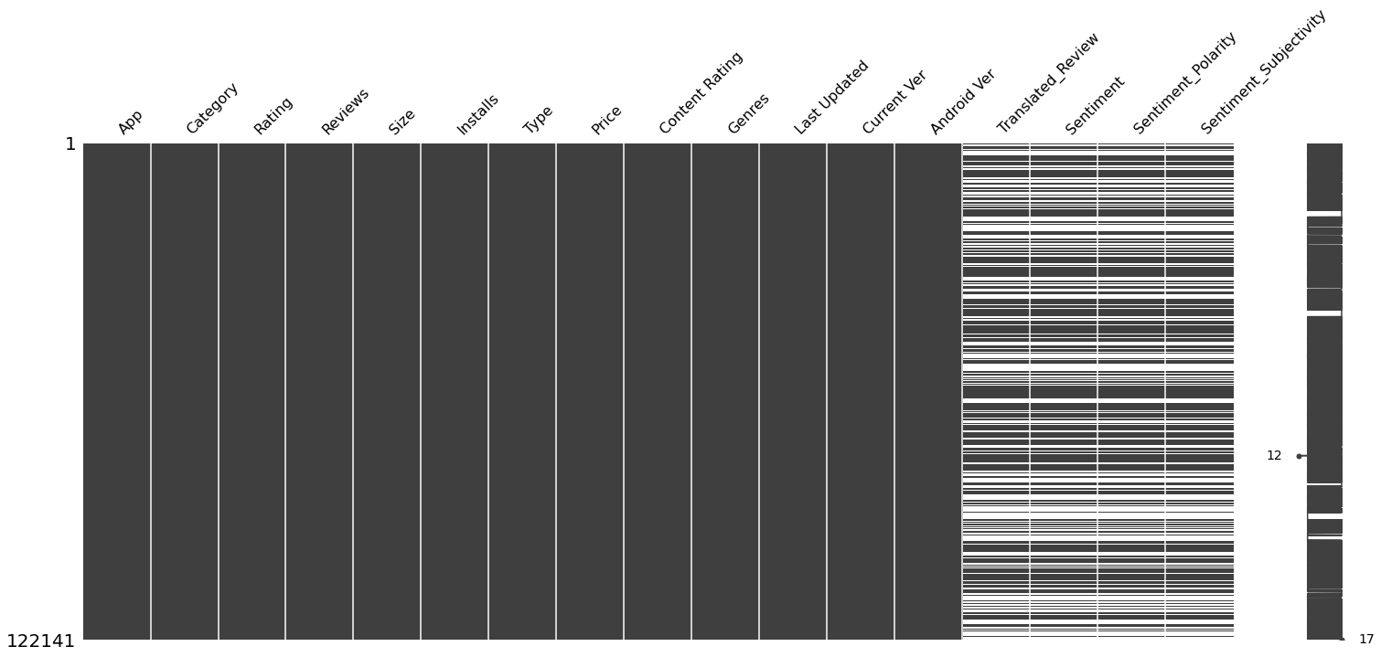
Analysis After Merginig Two Table
this is we got the number of null values in a table where we merged the user reviews and play store data set
then after that we do no of install type wise according to generes
here we shows the sentiments level as on positive , neutral , negetive
that is shown on next slide, in detail.

Slide 18
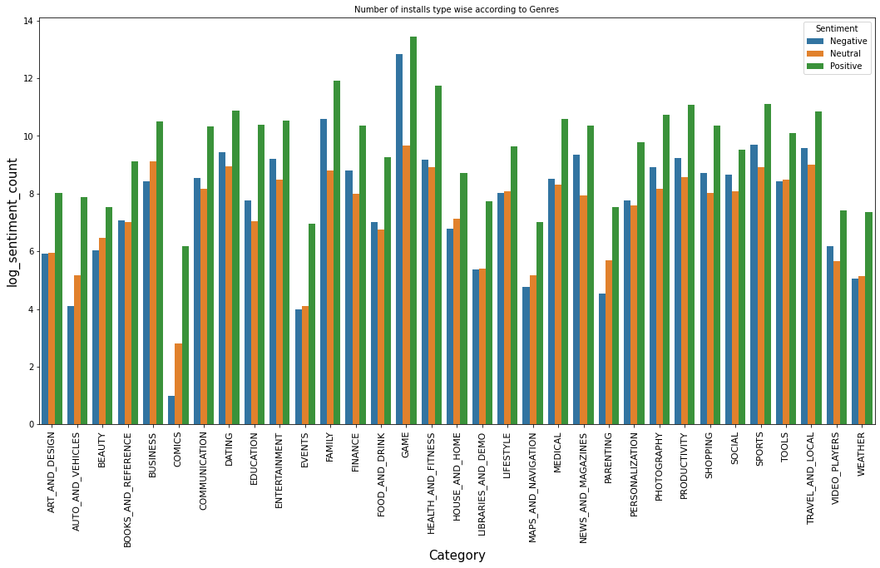
Number of Installs Type wise according to Genres

Slide 19
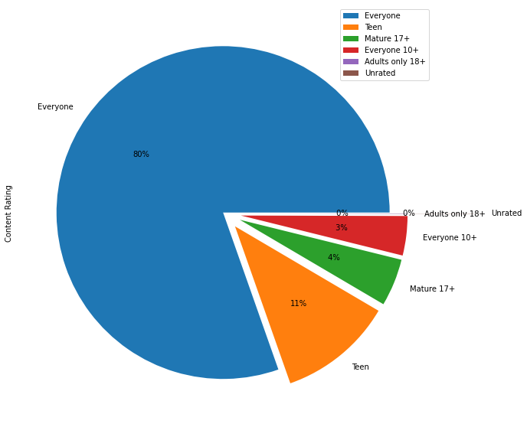
The Count of data of content for
perticular age group
this is the most important data analysis that we have find what will the restricted age or for what age categories , the App is made for . we can understand what age group will be our customer for what kin of app

Slide 20
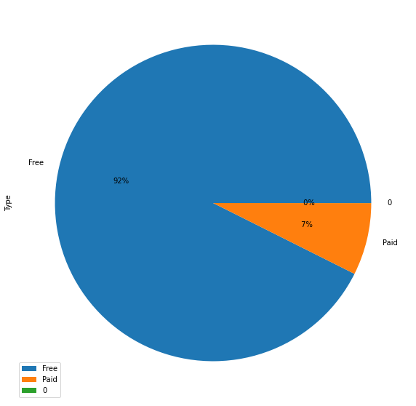
Free apps VS Paid apps Installs (Top genres based)
as the ast we just show the comparison between paid and free apps , so occupation of kinds of app available in market , we get

Slide 21
Challenges
w the first we face the challenge like to understand the business logic and data set and correrelation between thenn
then to deal the improper data
dependence of of one data column on another
between to fiind the meaning full instincts , we do several steps , several methods we performs and from thaat we learned that how to think when we anaalyze the data ,what mindset we have to keep while doing data analyzation

Slide 22
Conclusion
At the end we come to conclusion that the basic mantra of apps , that if we want to spread our app , make it free , if we want to make it rare , just make them paid.
It’s a factual and jokes apart
We solve interesting analysis which will helps bushiness to get the data flow and trends of current time!!

Slide 23
Thank You

